Slide 1
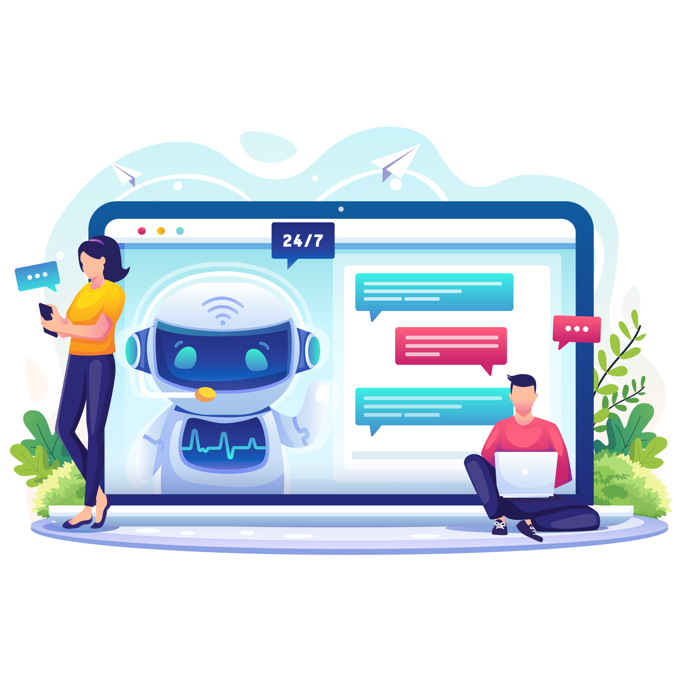
Banking bot powered by AI
Group members:
Mohammad Faizan (100886493)
Parth Patel (100893989)
Dev Pansiniya (100894010)
Chirag Jain (100592592)
Smit Kasla (100940803)

Slide 2
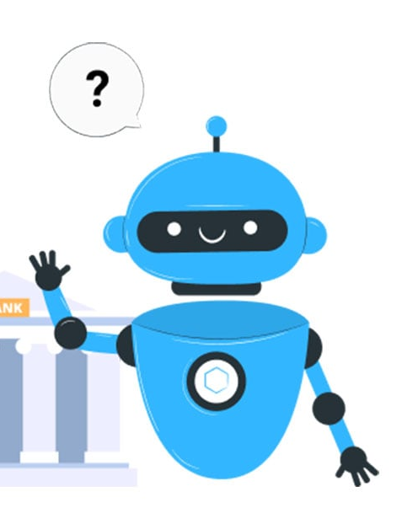
Overview
BANKING CHATBOT using NLP and Machine Learning is a project aimed at developing a chatbot system for banks that can assist customers with their inquiries, account information, and transactions. This system will utilize Natural Language Processing (NLP) and Machine Learning (ML) algorithms to provide an intelligent and personalized customer experience. Developing a chatbot system that meets these requirements presents several challenges.

Slide 3
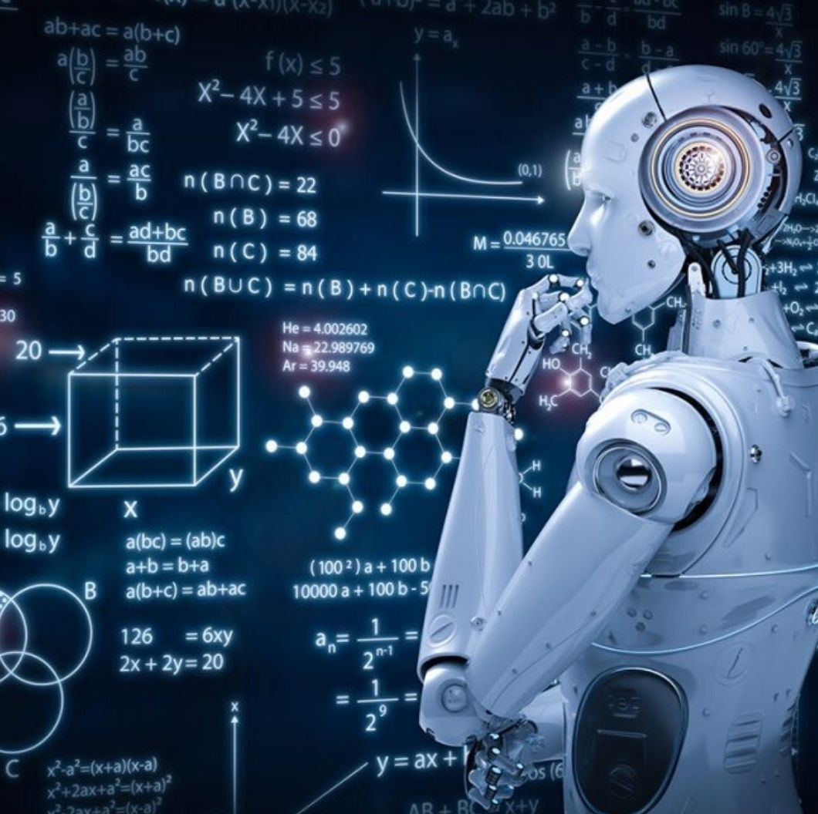
Technology USED
DATA SET INFORMATION
PYTHON PROGRAMMING
JUPYTER NOTEBOOK
NUMPY
PANDAS
SCIKIT-LEARN
NATURAL LANGUAGE PROCESSING
SUPPORT VECTOR CLASSIFIER
NAIVE BAYES
STREAMLIT

Slide 4
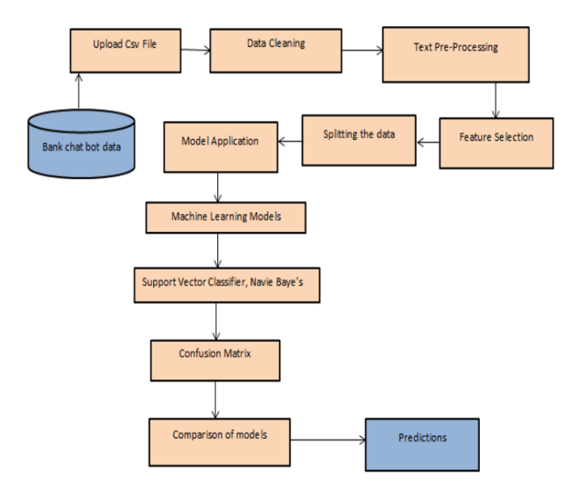
System architecture

Slide 5
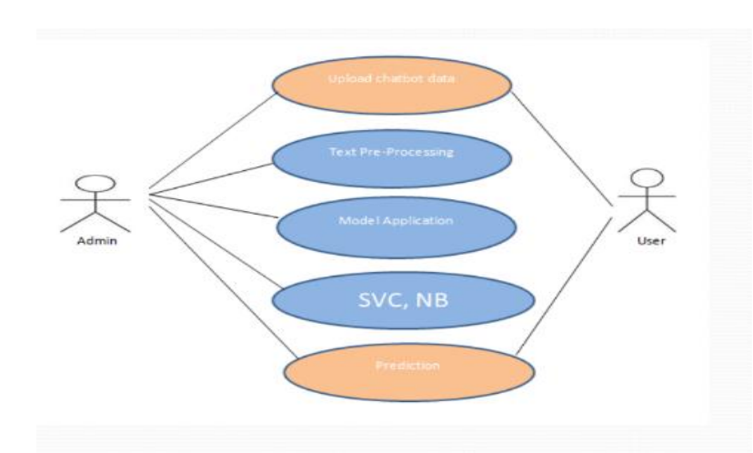
Use case diagram

Slide 6




AI features In bot
Intelligent Expense Tracking
Fraud Detection and Prevention
Personalized Rewards and Offers
Smart Savings Suggestions

Slide 7
Thank you

